Slide 1
How to Develop an Internal Grant Communication Plan
Michael E. Roman, MS
Grant Specialist
Cincinnati Children’s Hospital Medical Center
Welcome!
Notes:
Welcome to “How to Develop and Internal Grant Communication Plan.”
(Preparation notes:
1. Create stacks of hands out with the right number for each row.)

Slide 2
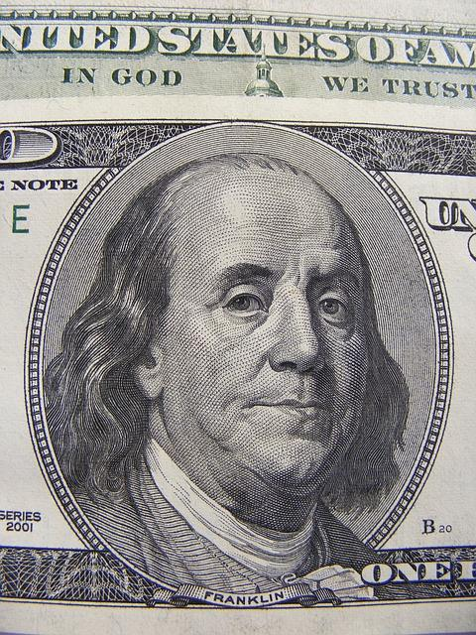
Sometimes a grant writer’s job feels like it’s all about the…
Notes:
Sometimes a grant writer’s job feels like it’s all about the money…
And why is it that people think grant writers can magically get money for them?

Slide 3
or...
Notes:
or… people thinking grant writing is about...

Slide 4

Writing
Notes:
Writing...because all it takes it FANTASTIC writing to get a grant.

Slide 5
or maybe it’s about….
Notes:
...or maybe it’s about...

Slide 6


Funders
Local government
State government
Foundations
Corporations
Notes:
Funders - And yes, it definitely is about funders.

Slide 7
*And it’s also about following the rules, sometimes appearing in very small print.
Notes:
Can anyone read what that says?
Yes, it’s also about following the rules, which sometimes appear in very small print.

Slide 8
And it is about...
Notes:
And it is about these things...money, writing, funders, and following the RFA to the letter.

Slide 9
but..
These are all important means to an end.
Notes:
but...these are all important means to an end.

Slide 10
The real end goal is...
Notes:
The real end goal is...

Slide 11
Mission:
Educating people
Improving child health
Feeding people
Inspiring society
Notes:
Mission:
educating people
improving child health
feeding people
inspiring society

Slide 12
How can an internal grant communication plan further your mission?
Notes:
So, how can an internal grant communication plan further your mission?
Solicit a few ideas from the audience

Slide 13
How would you rate your current internal communications about grants?
Notes:
How would you rate your current internal communications about grants?
Thumbs up, thumbs down, in the middle.

Slide 14
What are some of the barriers preventing you from carrying out the internal grant communication plan you want?
Notes:
What are some of the barriers preventing you from carrying out the internal grant communication plan you want?
Ask audience for input...
Lack of time, lack of resources, lack of content, lack of know-how

Slide 15
If I told you (and you agree)...
that an internal grant communication plan could further your mission...
Notes:
So, if I told you...that an internal grant communication plan could further your mission. (click)

Slide 16
...what would it be worth to you?
How much would you pay for an internal grant communication plan?
How much time would you give to it?
Notes:
What would it be worth to you? How much would you pay for an internal grant communication plan?
How much time would you give it?
(Now pass out hand-outs)
Use your handout to give answers to these questions.
Would anyone like to share a few answers.

Slide 17
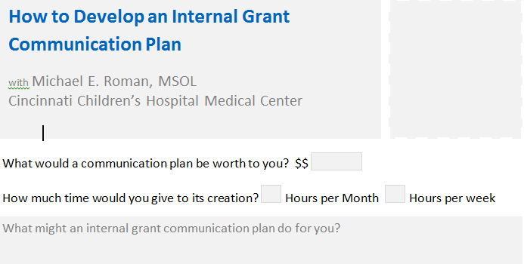
Use Your Handout
Fill in here
Notes:
You can fill in the answers to the previous questions on your handout.

Slide 18
Let’s Start Planning
Notes:
Let’s start planning...

Slide 19
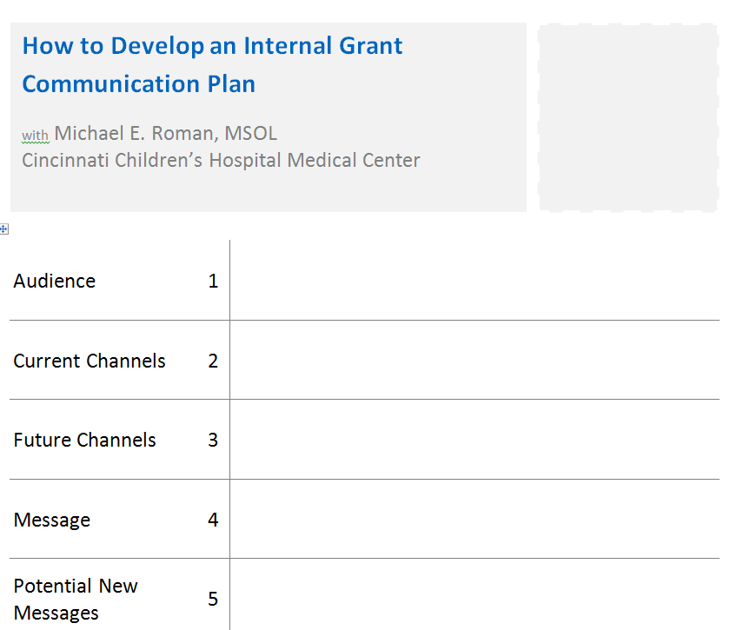
Notes:
Please use your sheet hand-out that looks like this… (click to next slide).
and start at the 1, circled in red, here.
Every time you see a number in this presentation, this will correspond with a number on your handout that you can fill in.

Slide 20
1. Who are the people that carry out your mission?
*Bonus if you can write out your entire mission statement on your handout.
Notes:
Who are the people that carry out your mission?
Since the focus of this communication plan is internal, you want to think about the people who carry out your mission, not the people to whom you deliver your mission.
I’ll give you 20-30 seconds to add some of the people who carry out your mission.
Consider asking for one or two audience member answers.

Slide 21
2. How, when & where do you communicate with those people who carry out your mission?
Notes:
Here’s the second question, again found on your handout. What are your people’s preferred methods of communication - email, meetings, paper documents, snail mail?

Slide 22
3. Are there new ways you would like to communicate with them?
Notes:
Are there new ways you would like to communicate with them? New times, maybe?

Slide 23
4. What do you currently say to them?
Notes:
What do you currently say to them? What are the important messages you are delivering?
What is the balance of information, news, celebration, and directions that you give them?

Slide 24
5. What would you like to say to them that you are not already?
Notes:
What would you like to say to them that you are not already?
Or is there anything you would like to reiterate?
So with those answers, let’s look at…(click)

Slide 25
Another Important Reason for Grant Communication→
Notes:
I wanted to talk about another important reason for grant communication

Slide 26
Grant work continuum
Manage grants and/or submissions
Grant writer writes grants
Program staff writes grants
Notes:
To set up the potential situation you might be in, here is a simple diagram. We all will find ourselves on various points of this spectrum for each grant we work on.
You may lean more toward the far right, grant writer end of the spectrum, but people can fall anywhere in between. At the far left would be people who are (use quote signs with fingers) “forced” to write grants, but are really program staff.

Slide 27
So how do we help everyone along the grant work continuum connect?
Notes:
So, how do we help everyone along the grant work continuum connect?

Slide 28
And how do we connect people who aren’t on the grant continuum at all?
Notes:
And also, how do we connect people who aren’t on the spectrum at all? These would be program staff, volunteers, or administrative people that might not even think about the fact that you have grants or that some of your programming depends on grants.

Slide 29
We communicate...
and with your answers to the first five questions, you’ve started your internal grant communication plan☺
Notes:
We communicate… and with your answers to the first five questions, you’ve started your internal grant communication plan.
Let’s jump into a …(Click)

Slide 30
Case Study
Cincinnati Children’s Hospital Medical Center
Division of Emergency Medicine
Research Newsletter
Notes:
Case study…
So, here is how the internal grant communication plan I’ve worked on developed.

Slide 31
Initial Set-up
3 months of background research
1.5 months of development
Delivered
  Tracked
  Iterated
Notes:
I took about three months when I started my position as a Grant Specialist in the Division of Emergency Medicine at Cincinnati Children’s Hospital Medical Center to review many of the internal documents available, work flows, standard operating procedures and others, and included in this was the past research newsletter and an internal Sharepoint intranet website. The past newsletter was delivered quarterly and in paper fashion.
After looking at all of this, I though a more frequent email newsletter might better combine the goals of the paper newsletter and the Sharepoint intranet site. I vetted this idea through the research teams leadership and it was a go.
I then developed an simple email newsletter template that looked like this (click)

Slide 32
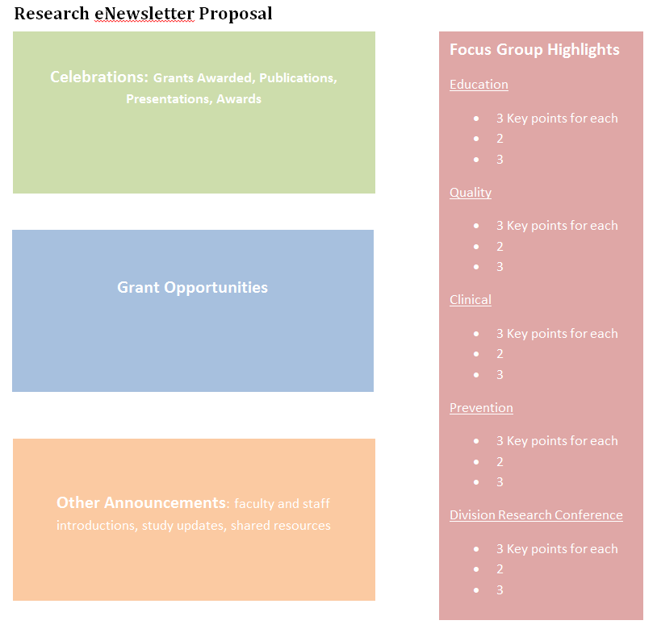
Content - initial outline
Notes:
Everything really began to move when II took this initial skeleton and made it a bit fancier and then filled with content.
The first newsletter was sent in August 2013 and has been delivered every month since then.
(click)

Slide 33
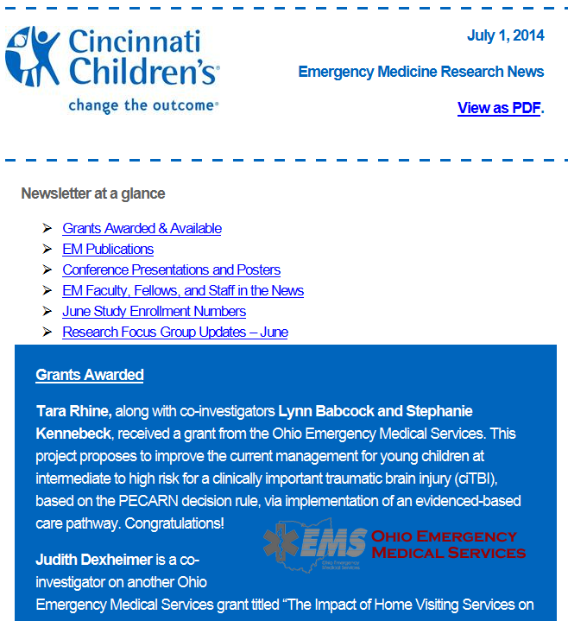
Current Newsletter
Notes:
Link to newsletter PDF as example.

Slide 34
Our Current Newsletter
Overall Goal:
Produce more well-funded and well-executed research
Notes:
So what was our overall goal for the project:
Being the “research” newsletter, our goal was to “Produce more well-funded and well-executed research that resulted in publications”.
Now in your case, the centerpiece of your communication plan might be staff meeting notes, staff memos, maybe another type of email you already send out. Whatever the case, it is good to have some specific goals for the communication.

Slide 35
...continued
Newsletter Objectives:
Increase awareness of funding opportunities
Increase awareness of current research, future research, and potential collaboration
Share resources
Celebrate research successes in the division
Notes:
To achieve that goal, our objectives were to…
Increase awareness of funding opportunities
Increase awareness of current research, future research, and potential collaboration
Share resources
Celebrate research successes in the division
So, the question for you is…(click)

Slide 36
6. What might the goal of your communication plan be?
Notes:
What might the overarching goal of your newsletter or communication be?
Again, you can fill this question out for #6 on your handout.
Sample might be…
Increase the ## of our clients securing jobs. (if you are a job training organization)

Slide 37
7. What objectives might you hope to accomplish?
Notes:
The objectives are what you hope your newsletter will provide to reach your goal.
So maybe you would like to increase the number of program staff who express interest in applying for grants.
Or maybe you want to increase the number of grants you are submitting but need more program ideas from staff.
Maybe you want to make better known the grant opportunities that might be available.
You may want to highlight the successes of your grant funded programs.
I’ll give you a moments to write some of your ideas out.

Slide 38
Our Audience
Faculty researchers, study staff, research administration, focus group members, 8th & 9th floor staff
Notes:
Something that may help refine your objectives and content is your audience.
Our audience:
faculty researchers
study staff
research administrators
focus group members (we have four distinct focus groups that meet monthly in four areas of research).
# 1 on your handout should have identified your audience to some degree. If you have any additional thought you can add them to number #1 now.

Slide 39
Our Schedule
Sent: the first Tuesday of each month
Submission deadline: the last Friday of each month
Notes:
Our current schedule for our newsletter is (read slide).

Slide 40
8. What could your potential schedule look like?
Notes:
What would make the most sense in your work flow, meeting schedules, etc.?

Slide 41
Our Metrics
Short-term
Track open rates
Track link clicks
Track email responses
Track verbal responses
Notes:
Some of our simple metrics are (read slide)

Slide 42
Metrics (continued)
Long-term
Track grants applied for
New collaborations
New grants applied for
Notes:
Some of the longer-term metrics we track are:
(read slide)

Slide 43
Sample Metrics

Slide 44
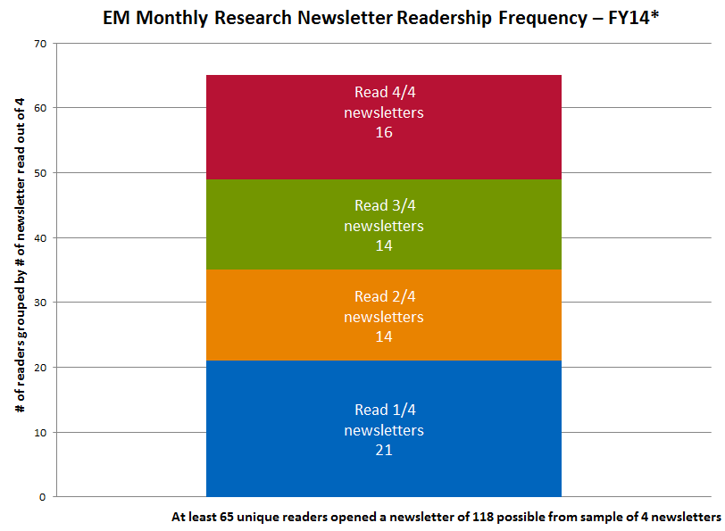

Slide 45
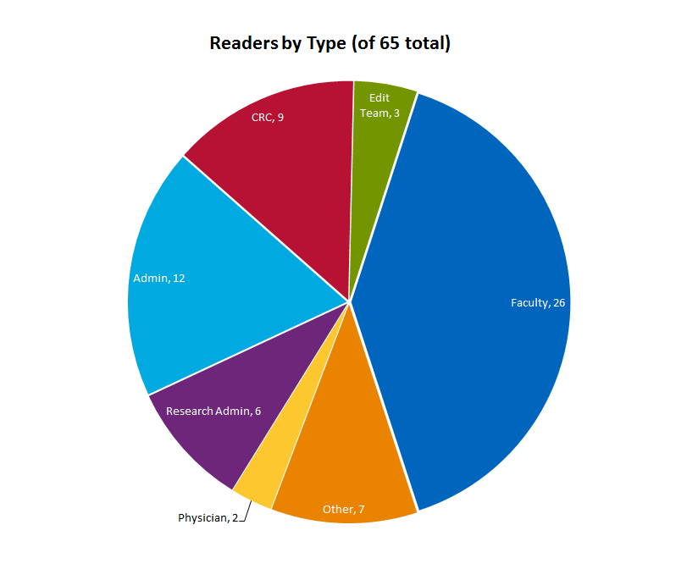
Faculty, 26

Slide 46
9. What metrics might you track?
What metrics are you already tracking that you could include?
Notes:
Depending on your channels, you may have different metrics.
Ex. If you print paper newsletters, maybe you put in mailboxes and do a visual check on how many are taken out within x number of days.

Slide 47
Content
Notes:
I showed this slide before. This was the simple outline I started with to sketch in what content could go where.

Slide 48
10. What content might you want to put in this communication?
Notes:
What content might you want to put in your newsletter.
You can put this in #10 on your handout.
There is also a Potential Content Blocks section on your handout you can fill out.

Slide 49
11.What content do you create that you could reuse?
What new content you create for this communication could you reuse elsewhere?
Notes:
As you’re thinking about content…(read slide)
(after a few moments) I’ll now take you into some of the finer details and tools that can help make this work?

Slide 50
Format for Delivery
We decided on an email newsletter, but you might do a paper newsletter,staff meeting notes, a bulletin board, or likely a combination of all of these.
Notes:
Read slide… maybe staff meeting notes are appropriate.
In fact, we have a set of bulletin boards that we fill with the first page of publications as they are published. This end product of our research highlights success for our division.

Slide 51
12. How will you deliver your communication(s)?
Notes:
How will you deliver your newsletter/communication?
This can go in the box for #12 on your handout.
Your answer here can also change your metrics in question #9.
Ex. If you print paper newsletters, may you put in mailboxes and do a visual check on how many are taken out within x number of days.
With the completion of those answer…(click)

Slide 52
Quick 90 second break
You can take notes and add questions in the box provided below #12.
90 second countdown
Notes:
Let’s take a quick 90 second break to stretch.
You can also jot down a few quick notes or questions in the box provided below #12.

Slide 53
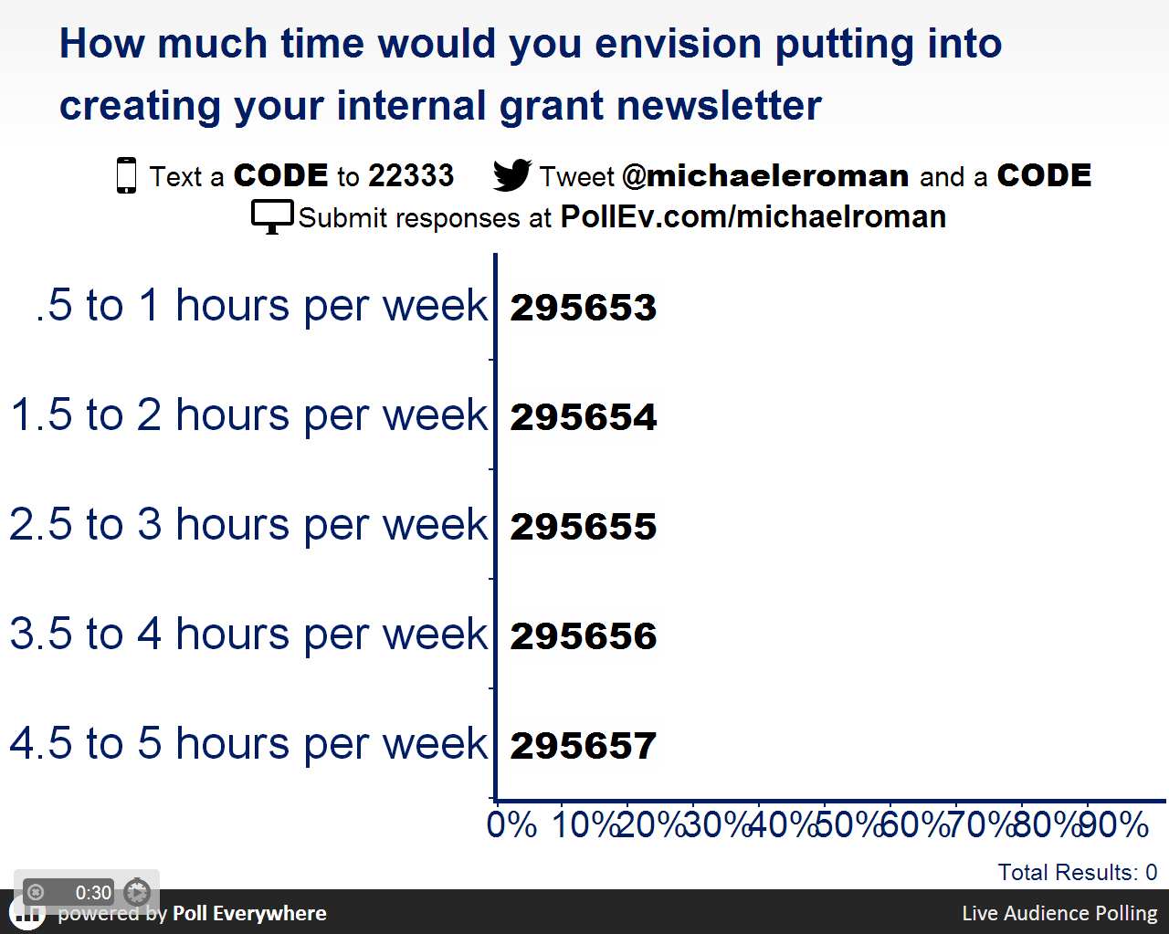
Let’s share some thoughts
Notes:
Your answers to the next few questions can come directly from your handout.
1 - (Explain what’s going on)
Now I’m going to ask for your opinion. You’ll use your phones to respond just like on American Idol. So please take out your cell phones, but remember to leave them on silent.
You’ll participate by sending a text message or visiting my voting web page from any browser.
2 - (Address their concerns)
This is a just standard rate text message, so it may be free for you, or up to twenty cents on some carriers if you do not have a text messaging plan.
The service we are using is serious about privacy. We cannot see your phone numbers, and you’ll never receive follow-up text messages outside this presentation. There’s only one thing worse than email spam – and that’s text message spam because you have to pay to receive it!”
3 - (Use a demo or practice poll)
Let’s do a quick poll now to get the hang of it. Everyone take out your mobile phone and tell me your first name (or where you traveled from today, or what you for breakfast, or your favorite cola, or anything you like.)
(If voting by text message), start a new message and put the phone number or five digit code in the “to” line. Put the key code followed by your answer in the body of the message.
(If voting via the web), visit pollev.com/(your personal pollev page). Wait for the poll and respond with a click.

Slide 54
Tools
Goo.gl - link tracking
Piktochart.com - charts
Google Alerts - news tracking
Mailchimp - email newsletter
Google Docs - general, forms
Notes:
Click link to each and share…
Goo.gl - this is needed if you are not using an email newsletter service like Mailchimp. If using Mailchimp or other services, they will auto track links for you.
Piktochart - I set up a template and then just fill-in each month
Google Alerts - I use this to track news about our division faculty
Mailchimp - service I recommend if you are sending to any external constituents. Or use whatever service your organization is using already.
Google Docs - spreadsheets are powerful, but I use it for free forms or surveys. You could use the Forms as you start your internal communications and gather feedback.

Slide 55
Final Tips
Notes:
Here are a few final tips.

Slide 56
Develop a Plan
Develop a Routine
...and write it down.
...and write it down.
Notes:
Develop a plan.
You should have a good start to your plan in front of you. It doesn’t really need to be much more than this.
Develop a routine.
And you can start writing down your routine from the beginning when you start this process. It will save you so much time in the long run.

Slide 57
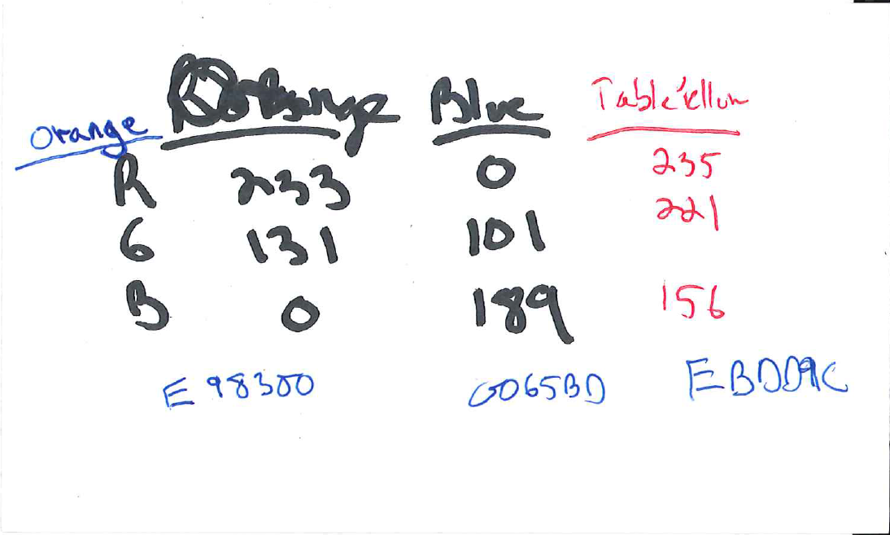
Sample - standard colors
Notes:
Developing your process doesn’t need to be overwhelming.
This is a sample of how I initially (and still) track the colors to use in our newsletter, charts, etc.

Slide 58
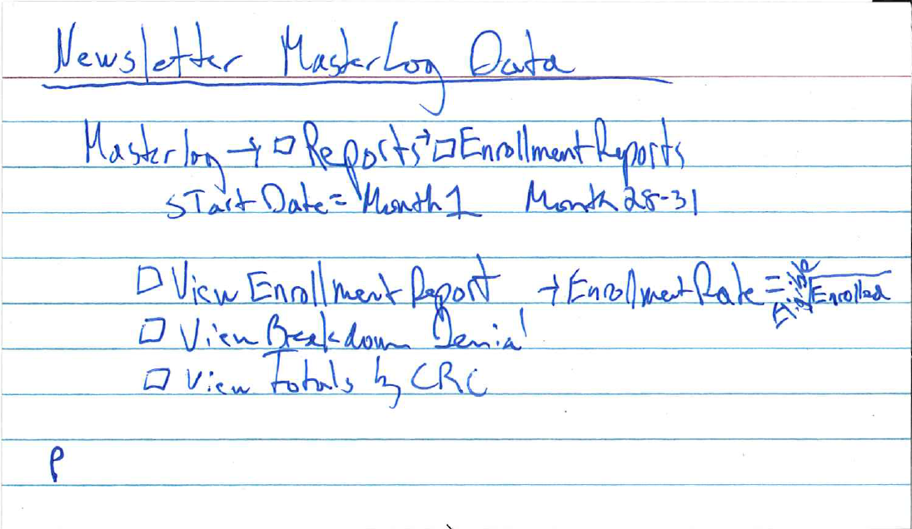
Sample - report creation
Notes:
This is a sample of how I wrote down the process to create reports I needed each month.

Slide 59
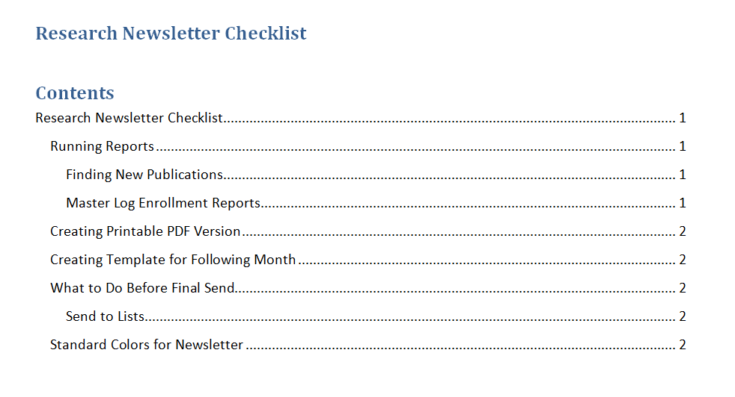
Sample - more formal guide
Notes:
(Included in your handout)
But you can also develop a more formal guide. This is great when someone needs to cover for you, or someone leaves, or duties change. It will also help your own workflow move much more quickly.
(Click on picture-link to show full guide.)

Slide 60
Conclusion
Use your communication plan to…
Highlight grant successes
Share current progress on grants
Announce grant opportunities
Share potential grant resources
Increase grant collaborations
Further your mission
Notes:
Use your communication plan to…
Highlight grant successes
Share current progress on grants
Announce grant opportunities
Share potential grant resources
Increase grant collaborations
Further your mission

Slide 61
Thank you for attending!
Please contact me with any questions as you start the process.
Michael Roman
Cincinnati Children’s Hospital Medical Center
michael.roman@cchmc.org

